Slide 1

MINOR PROJECT
MAULANA AZAD NATIONAL INSTITUTE OF TECHNOLOGY
Stance Detection with Sentiment Analysis and Sarcasm Detection
Dishant Pandauria 181112226
Ragini Kalvade 181112256
Raj Mehroliya 181112244
Vanshika Agrawal 181112246
Under the Guidance of Dr. Saritha S K
DEPARTMENT OF COMPUTER SCIENCE AND ENGINEERING

Slide 2
INTRODUCTION
Stance is defined as the expression of the speaker’s standpoint and judgement toward a given proposition
An individual’s stance towards something can be often detected through the person’s utterances. The stance can be expressed using any sentiment but sentiment analysis alone is not sufficient.
The huge dependency of users on social media platforms as their main source of communication allows researchers to study different aspects of online human behavior, including the public stance toward various social and political aspects

Slide 3
LITERATURE REVIEW
Somasundaran and Wiebe, 2010 [Reference - 7] - Presented a stance detection approach based on sentiment and arguing features, along with an arguing lexicon automatically compiled.
Saif M. Mohammad, Parinaz Sobhani and Svetlana Kiritchenko. 2016 [Reference -2]. - A model for stance classification in tweets was proposed where the interactions between the stance target, stance, and sentiment were modeled.
Yingjie Li and Cornelia Caragea, 2016 [Reference - 1] - Proposed an attention-based multitask learning framework and integrate lexicon information to achieve better performance

Slide 4
RESEARCH GAPS IDENTIFIED
In the sentiment analysis of a tweet, the presence of sarcasm is not given consideration. This can lead to misleading results.
No feature provided where we can evaluate the overall stance of a target-entity.
Lack of proper datasets to train model which affects model training.

Slide 5
PROBLEM DEFINITION
The aim is to identify sentiments and sarcasm in tweets and analyse it, to obtain an overall stance towards a particular target.
A multilevel framework is proposed which takes into consideration the sentiment and the presence of sarcasm in the text and provides with the overall stance towards the target.
The model also provides an overall stance for a target based on all the tweets gathered.

Slide 6
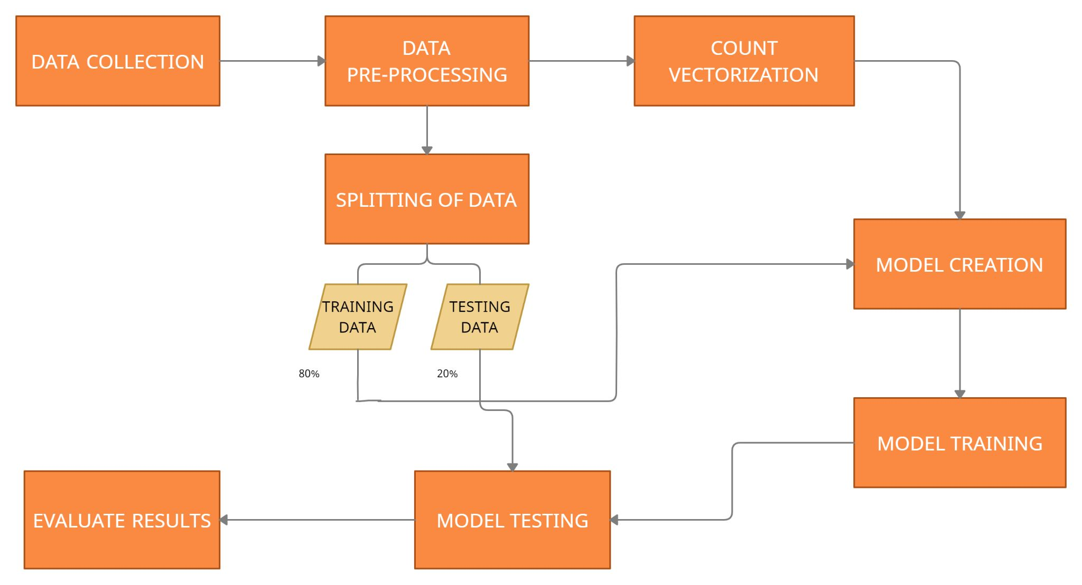
METHODOLOGY

Slide 7
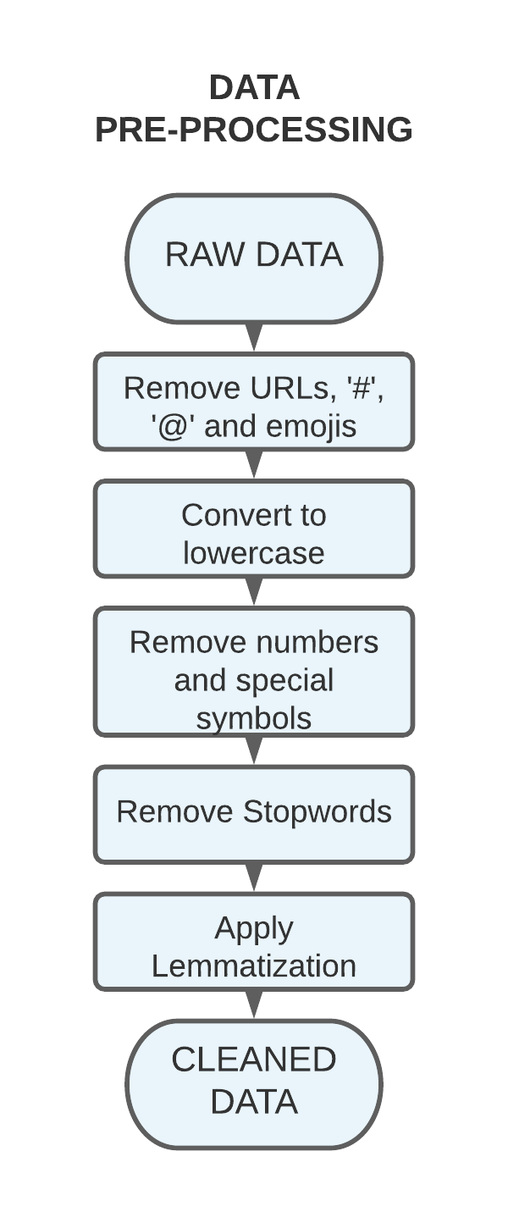
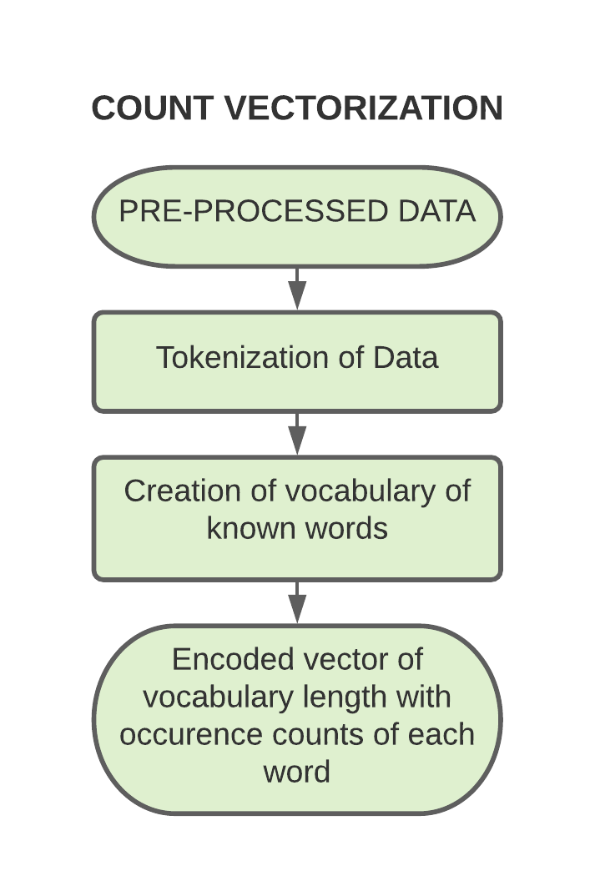
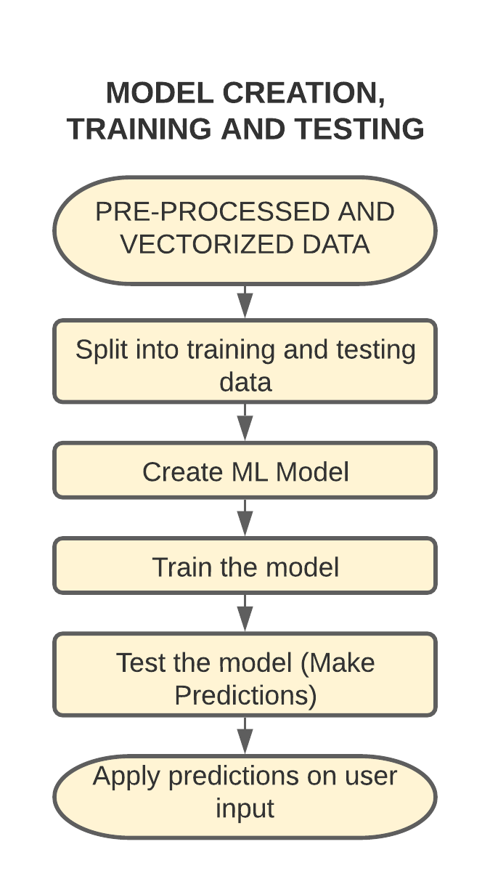

Slide 8
TECHNOLOGIES USED
Python
Machine Learning
Django
Sqlite
Html
Css
Bootstrap
JavaScript
Git

Slide 9
ARCHITECTURE

Slide 10
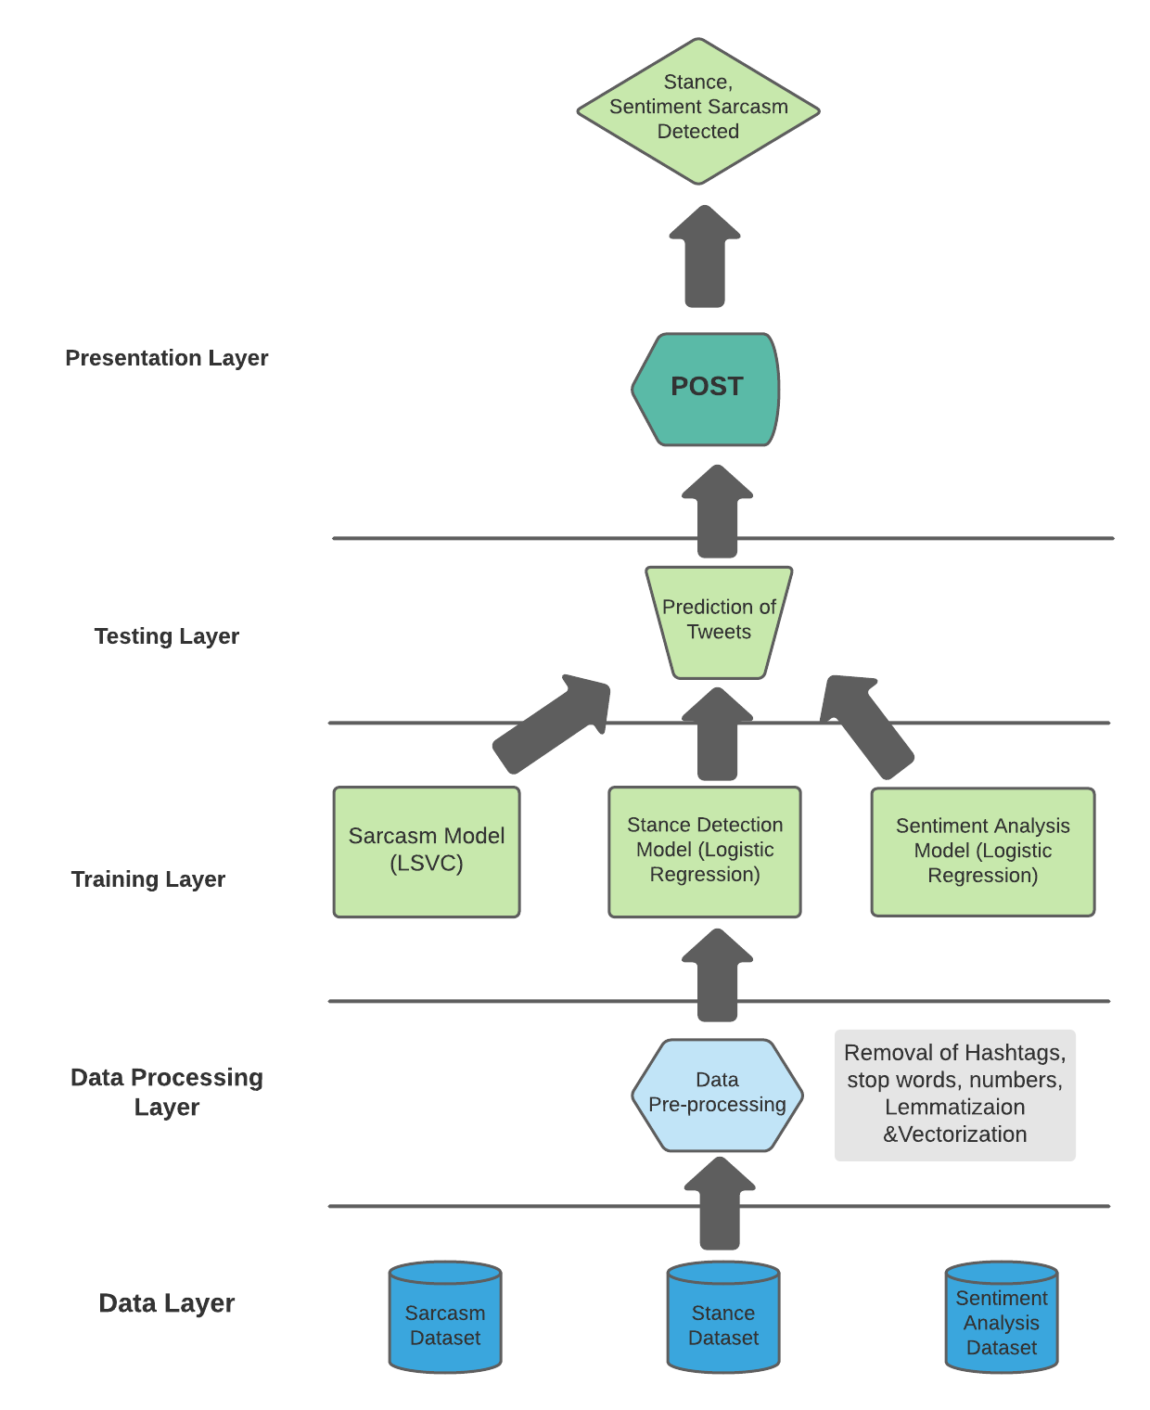

Slide 11
MODELS AND THEIR RESULT DISCUSSION

Slide 12
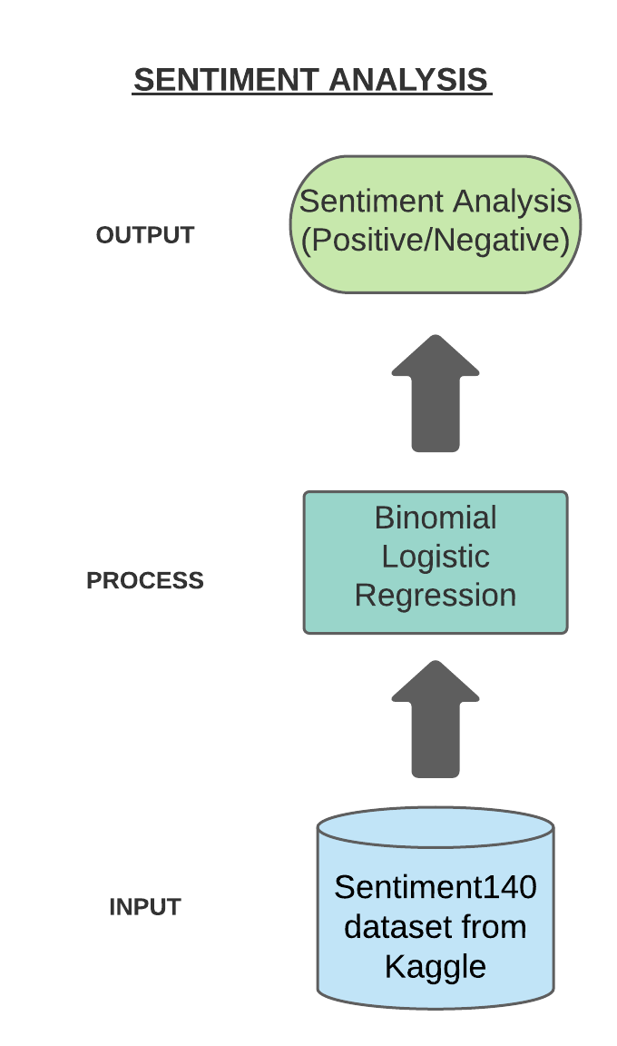
Sentiment Analysis
A person may express the same stance towards a target by using negative or positive language. Therefore, the sentiment of a tweet as a factor is considered.
Model - The model used here is Binomial Logistic regression. It is a supervised learning classification algorithm used to predict the probability of a target variable. The nature of target or dependent variable is dichotomous, which means there would be only two possible classes.
Dataset - Sentiment140 dataset from Kaggle (contains over 1.6 million tweets)

Slide 13
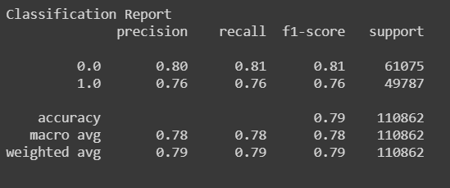

The accuracy achieved by the sentiment analysis model is 78.56%.
Testing of User Input

Slide 14
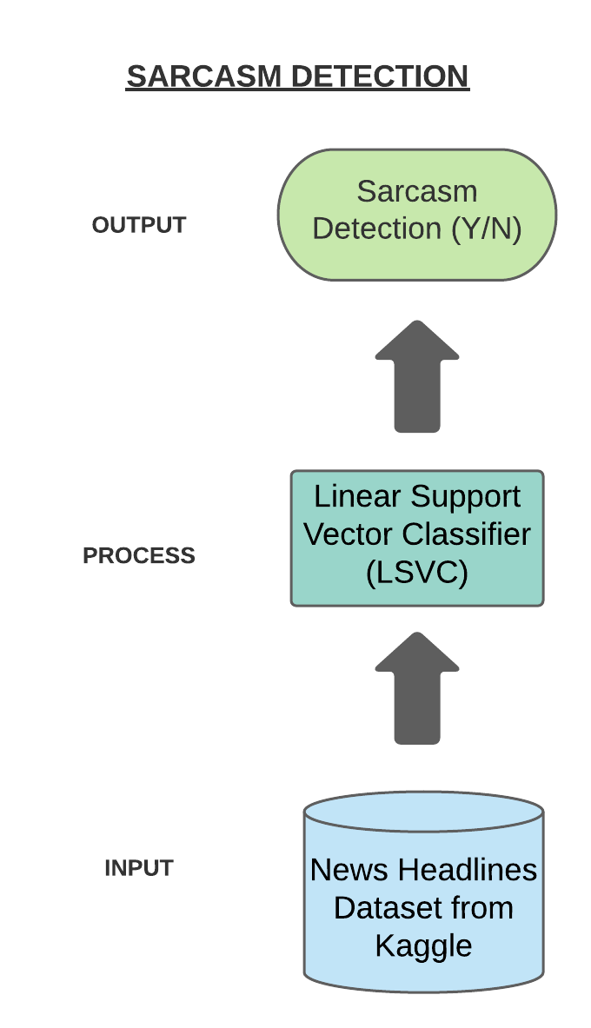
Sarcasm Detection
Sarcasm detection is a crucial step to stance detection, considering the prevalence and challenges of sarcasm in sentiment-bearing text.
Model - The project has implemented the use of Support Vector Machines i.e, the Linear Support Vector Classifier (LSVC). The objective of the support vector machine algorithm is to find a hyperplane in an N-dimensional space(N-the number of features) that distinctly classifies the data points.
Dataset - News Headlines Dataset from Kaggle (contains over 26,000 tweets)

Slide 15
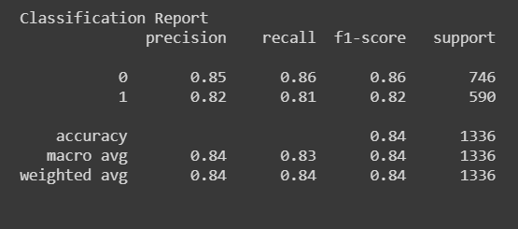

The accuracy achieved by the sarcasm detection model is 83%.
Testing of User Input

Slide 16
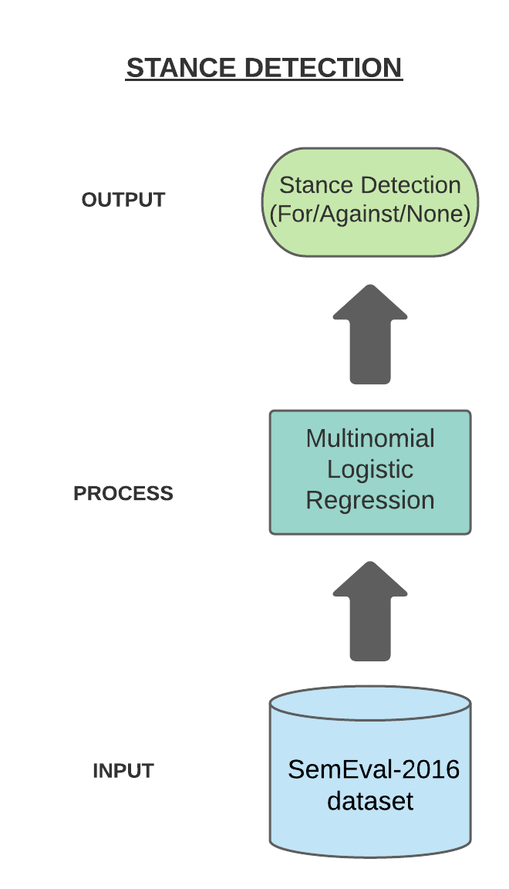
Stance Detection
Stance detection is the task of automatically determining from text whether the author of the text is in favor of, against, or neutral towards a proposition or target.
Model - The model used here is Multinomial Logistic regression. It is a supervised learning classification algorithm used to predict the probability of a target variable. It is a classification method that generalizes logistic regression to multiclass problems, i.e. with more than two possible discrete outcomes(here, 3).
Dataset - SemEval-2016 dataset (contains over 12,000 tweets)

Slide 17
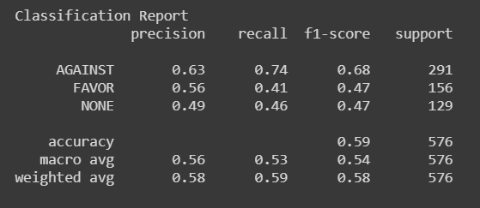
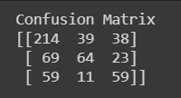

The accuracy achieved by the stance detection model is 58.5%.
Testing of User Input

Slide 18
Conclusion
To sum up, a multi-level framework based on ML models and stance, sentiment analysis and sarcasm detection as factors has been employed. By determining whether text is sarcastic or not, a better insight is provided for stance detection.
The project built has provided with fairly accurate results and gives an overall stance of the target-entity in real time.
By taking the influence of sentiments and sarcasm of the tweet, we have provided more accurate results backed by more than one conclusive model.

Slide 19
Future Scope
The different models have shown that there is room from improvement and experimentation in stance detection. The future scope of the project would be to remove the restriction of target and dynamically update the target entities without requiring retraining of the models’ multiple times.
The project could be improved if the output of the sentiment analysis and sarcasm detection models be used as a layer for detection of stance.

Slide 20
References
Multi-Task Stance Detection with Sentiment and Stance Lexicons - https://www.aclweb.org/anthology/D19-1657.pdf
Stance and Sentiment in Tweets - https://arxiv.org/pdf/1605.01655.pdf
A lexicon-based method for Sentiment Analysis using social network data - https://csce.ucmss.com/books/LFS/CSREA2017/IKE6023.pdf
Stance Detection on Social Media: State of the Art and Trends - https://arxiv.org/pdf/2006.03644.pdf
Sentiment Analysis - lexicon based approach - https://alphabold.com/sentiment-analysis-the-lexicon-based-approach/
Twitter Sentiment Analysis - https://arxiv.org/pdf/1507.00955.pdf

